Slide 1
CIS 450 Final Project
Airbnb Explorer
Ali Sulaiman Mohammad, Mirriam Ronoh, Durga Srivatsan, Shivin Uppal

Slide 2
About Airbnb Explorer
Allow owners autonomy and the opportunity to gain information to help best market their property
Provide information and key analytics for owners
Give a unique experience to the AirBnB Seattle database

Slide 3
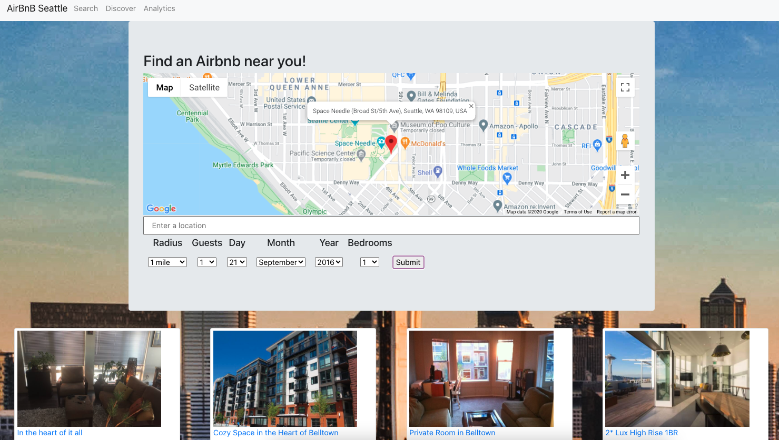
Preview

Slide 4
Dataset and Technology:
Dataset:
https://www.kaggle.com/airbnb/seattle
3 Tables:
Calendar.csv (1.39 million tuples)
Listing.csv (3818 tuples)
Reviews.csv (84,800 tuples)
Technology:
Oracle SQL database on AWS RDS.
Python for cleaning data
The Google Map API with react-google-maps, react-google-autocomplete and react-geocode
Sklearn’s LDA and Countvectorizer in Python

Slide 5
Demo!

Slide 6
Query Optimizations

Slide 7
50%
Adding indexes alone cut the runtime of our most expensive & most used query by 50%!

Slide 8
Let’s talk about runtimes
Query | Non-Optimized (seconds) | Optimized (seconds)
Discover Airbnbs | 13.157 | 0.648
Average Price per Zipcode | 0.473 | 0.218
Highest Annual Revenue per Square Foot | 0.261 | 0.226
Get Listings with Average Number of beds, bedrooms and bathrooms | 0.45 | 0.03
Get Apartment Airbnbs that accommodates extra people | 11 | 0.2
Airbnbs in a given Zipcode matching certain criteria | 0.525 | 0.457

Slide 9
How we optimized the queries
Indexes: A lot of our queries involved searching & filtering, so creating indexes on these parameters made our queries a lot faster
Temporary Tables: We avoided multiples joins & subqueries by creating temporary tables
Reducing join sizes: We performed selections before performing large joins, especially with the Calendar table (1.39 million rows)
Fortunately, a lot of our relationships were 1:1, so most joins were relatively inexpensive.

Slide 10
Sample Unoptimized Query (0.45 seconds)
WITH AvgBathrooms AS (SELECT ROUND(AVG(a.bathrroms),0) AS bathrooms FROM amenity a),
AvgBedrooms AS (SELECT ROUND(AVG(a.bedrooms),0) AS bedrooms FROM amenity a),
AvgBeds AS (SELECT ROUND(AVG(a.beds),0) AS beds FROM amenity a),
MaxBathroomListings AS(SELECT a.listing_id, a.bathrroms AS bathrooms FROM amenity a JOIN AvgBathrooms m
ON (a.bathrroms >= m.bathrooms - 1) AND (a.bathrroms <= m.bathrooms + 1)),
MaxBathroomBedRoomListings AS(SELECT a.listing_id, a.bathrroms AS bathrooms, a.bedrooms AS bedrooms
FROM amenity a JOIN AvgBedrooms m ON (a.bedrooms >= m.bedrooms - 1) AND (a.bedrooms <= m.bedrooms + 1)),
MaxListings AS(SELECT a.listing_id, a.bathrroms AS bathrooms, a.bedrooms AS bedrooms, a.beds AS beds
FROM amenity a JOIN AvgBeds m ON (a.beds >= m.beds - 1) AND (a.beds <= m.beds + 1)),
Prices AS (SELECT ROUND(AVG(l.Price), 0) AS average_price, MAX(l.Price) AS max_price, MIN(l.Price) AS min_price
FROM listing_policy l),
AvgListings AS (SELECT l.listing_id, l.price AS price
FROM listing_policy l JOIN Prices p ON l.price >= (p.average_price - 100) AND l.price <= (p.average_price + 100)),
Temp AS (
SELECT DISTINCT p.listing_id AS listing, a.price AS price, p.bathrooms AS bathrooms, p.bedrooms AS bedrooms, p.beds AS beds, d.name
FROM AvgListings a JOIN MaxListings p ON a.listing_id = p.listing_id JOIN Descriptions d ON p.listing_id = d.listing_id
WHERE a.price >= 200
ORDER BY a.price DESC)
SELECT * FROM Temp WHERE ROWNUM <= 15

Slide 11
Sample Optimized Query (0.03 seconds)
WITH Max AS (
SELECT ROUND(AVG(a.bathrroms),0) AS bathrooms, ROUND(AVG(a.bedrooms),0) AS bedrooms, ROUND(AVG(a.beds),0) AS beds
FROM amenity a),
MaxListings AS(
SELECT a.listing_id, a.bathrroms AS bathrooms, a.bedrooms AS bedrooms, a.beds AS beds
FROM amenity a JOIN Max m
ON (a.bathrroms >= m.bathrooms - 1) AND (a.bedrooms >= m.bedrooms - 1) AND (a.beds >= m.beds -1)
AND (a.bathrroms <= m.bathrooms + 1) AND (a.bedrooms <= m.bedrooms + 1) AND (a.beds <= m.beds + 1)),
Prices AS (
SELECT ROUND(AVG(l.Price), 0) AS
average_price, MAX(l.Price) AS max_price, MIN(l.Price) AS min_price FROM listing_policy l),
AvgListings AS (
SELECT l.listing_id, l.price AS price
FROM listing_policy l JOIN Prices p
ON l.price >= (p.average_price - 100) AND l.price <= (p.average_price + 100)),
Temp AS ( SELECT DISTINCT p.listing_id AS listing, a.price AS price, p.bathrooms AS bathrooms, p.bedrooms AS bedrooms, p.beds AS beds, d.name
FROM AvgListings a JOIN MaxListings p
ON a.listing_id = p.listing_id JOIN Descriptions d ON p.listing_id = d.listing_id
WHERE a.price >= 200
ORDER BY a.price DESC)
SELECT * FROM Temp WHERE ROWNUM <= 15

Slide 12
Extra Credit Features

Slide 13
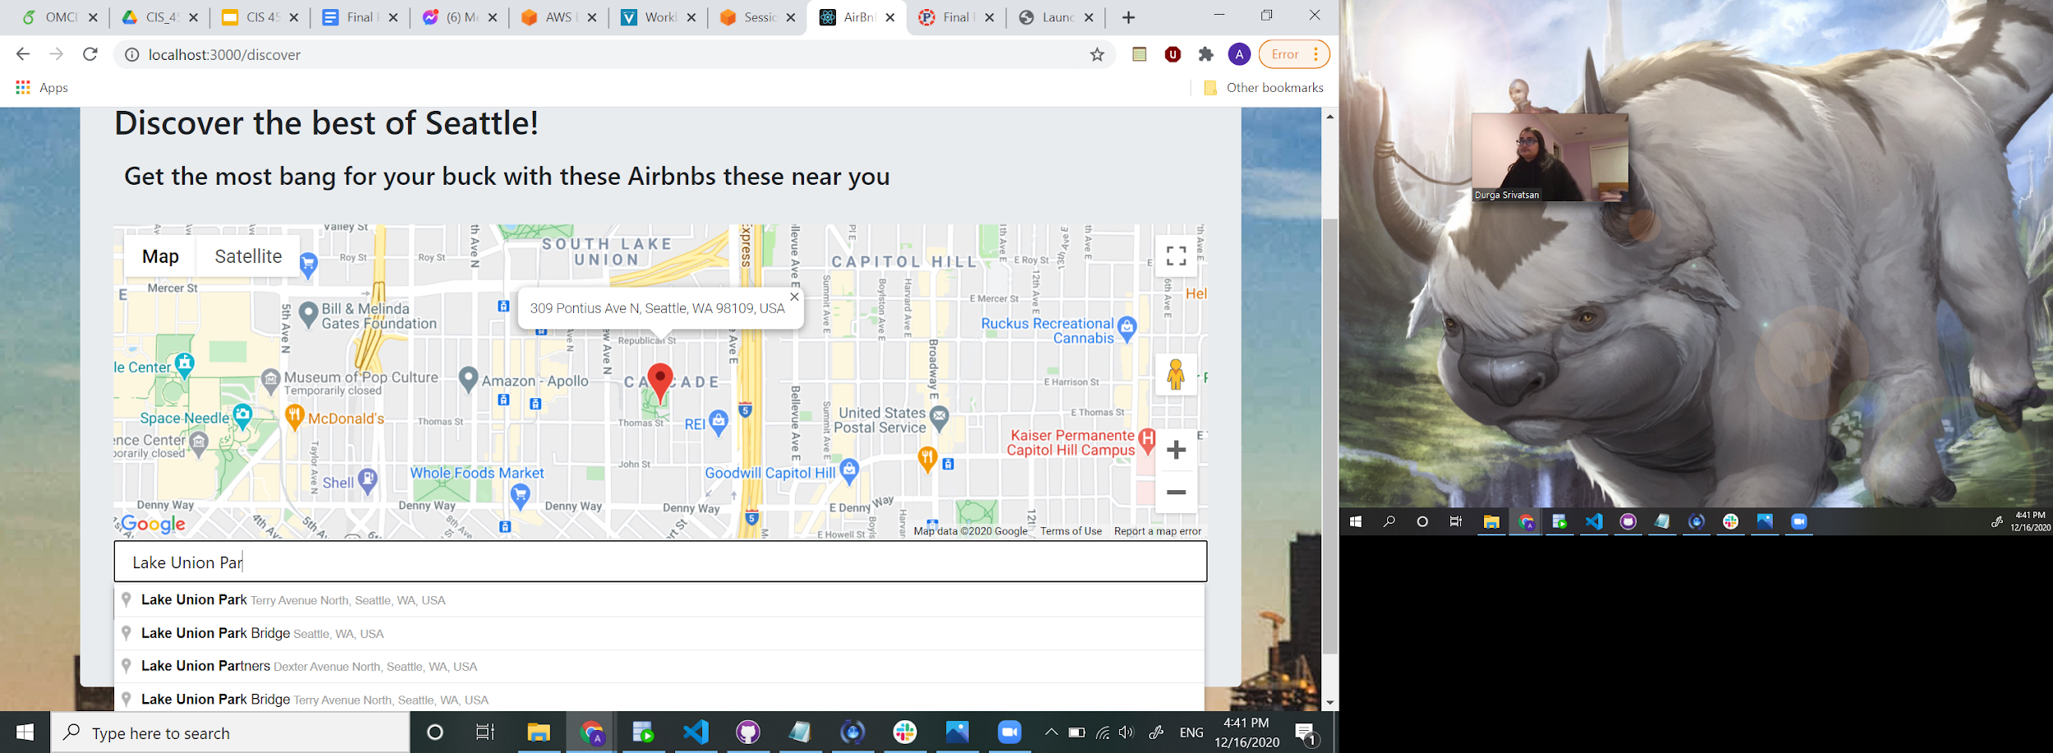
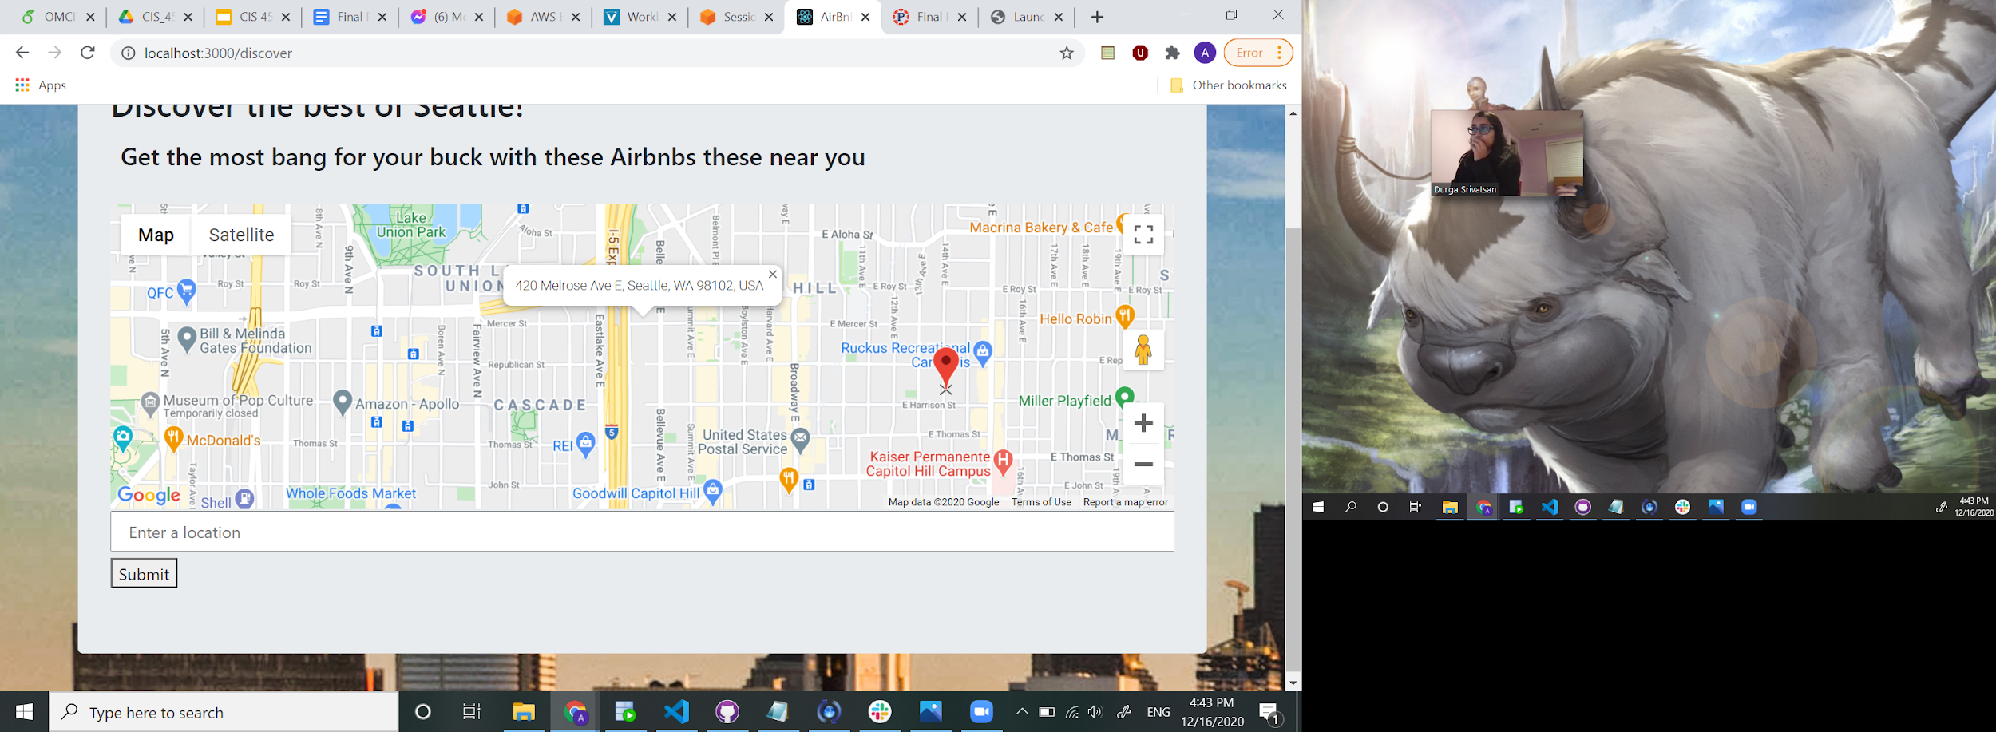
Google Maps API Integration
We learnt how to integrate the Google Maps API with our JavaScript Web App
Used the API to enable users to search for Airbnbs at a location near them
Users can also toggle different locations on the map

Slide 14
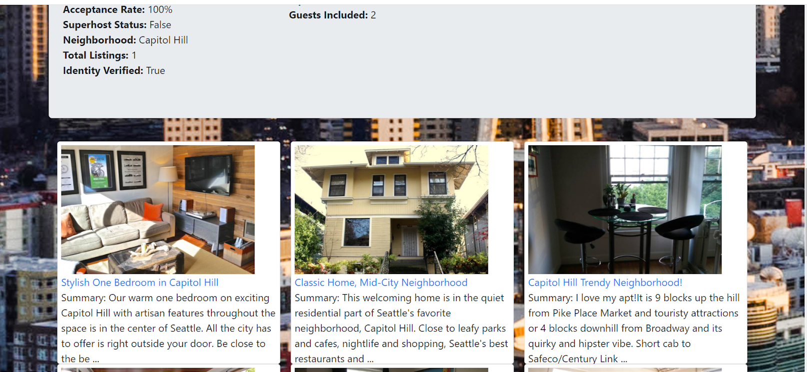
Machine Learning
Users can be recommended listings based on how similar its description is to the current listing.
LDA was used to cluster airbnbs into ‘topics’ for this purpose
Keywords for two of the topics are shown. Topic 2 can be seen to be for people who want to explore the great outdoors vs Topic 4 for people who want to enjoy the city’s attractions.

Slide 15
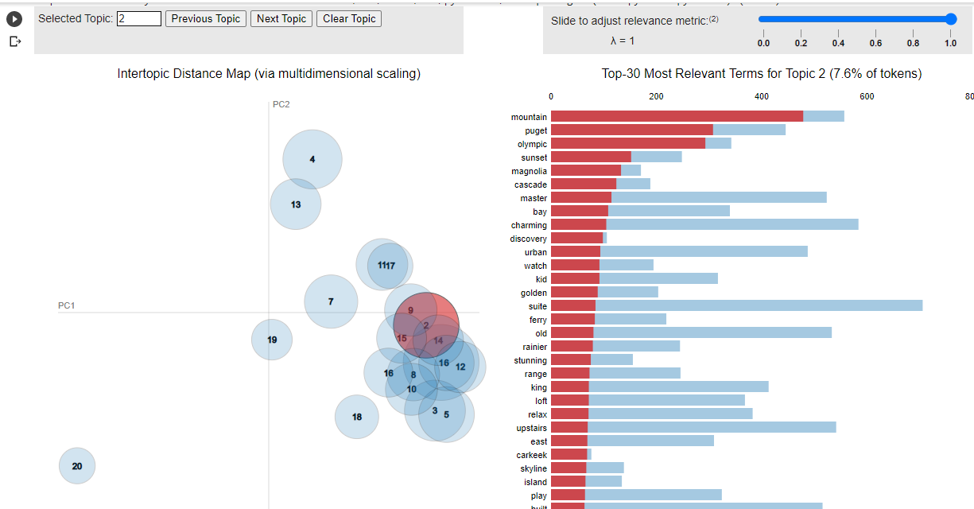

Slide 16
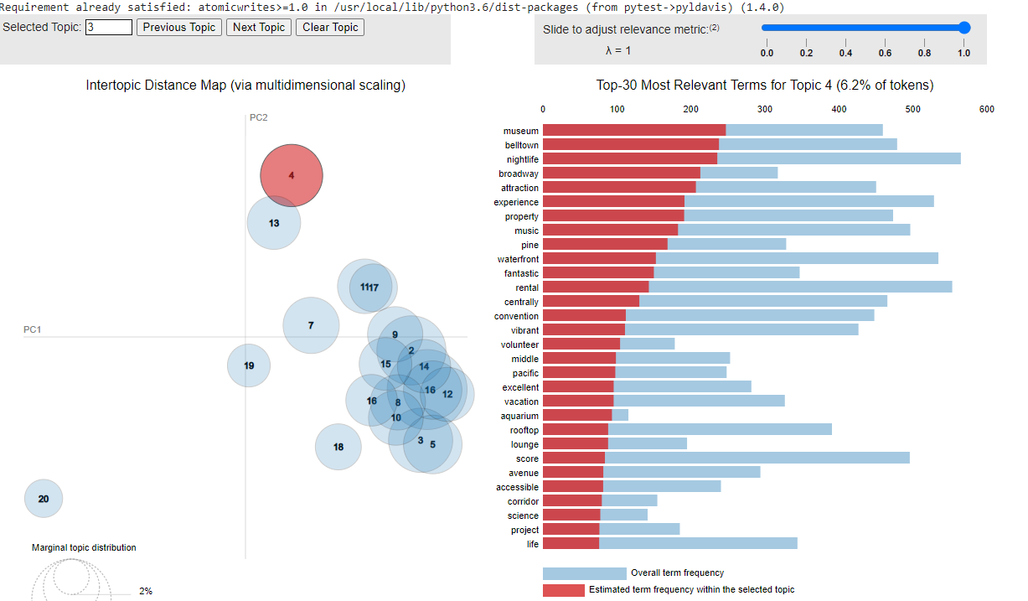

Slide 17

Thanks!
We’d be happy to answer any questions. Please reach out to us via email!
shivin@wharton.upenn.edu
dsri@seas.upenn.edu
mirriam@seas.upenn.edu
alism@seas.upenn.edu

